Slide 1

Real-Time Interactive RFID-Based Classroom Attendance System with Web Visualization
Streamlining classroom attendance tracking with RFID technology and real-time web visualization. This automates attendance, reduces errors, and provides a user-friendly interface.

Slide 2

Project Goals and Objectives
1
Automate Attendance
Eliminate manual processes.
2
Real-Time Visualization
Immediate attendance display.
3
Enhance Accuracy
Minimize data entry errors.
4
Efficient Data Management
Centralized data processing.

Slide 3
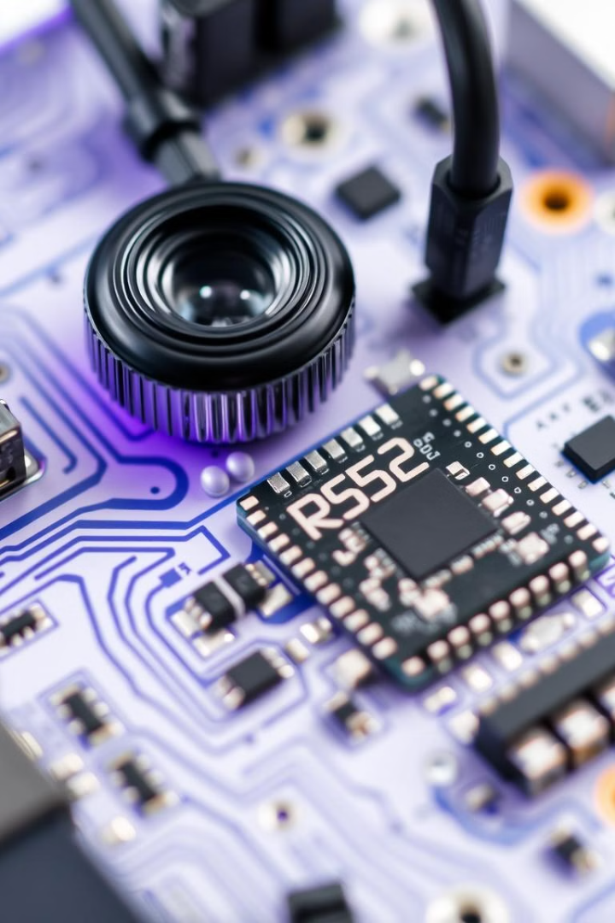



Hardware Components
RFID Readers (RC522)
Capture student ID cards.
ESP32 Microcontroller
Processes RFID data.
Multiplexers
Manages multiple RFID readers.

Slide 4
Software Components: Web Application
Visual Representation
Real-Time Data
User Interface
Interactive classroom bench layout.
Student roll numbers on seats.
Clean design for readability.

Slide 5
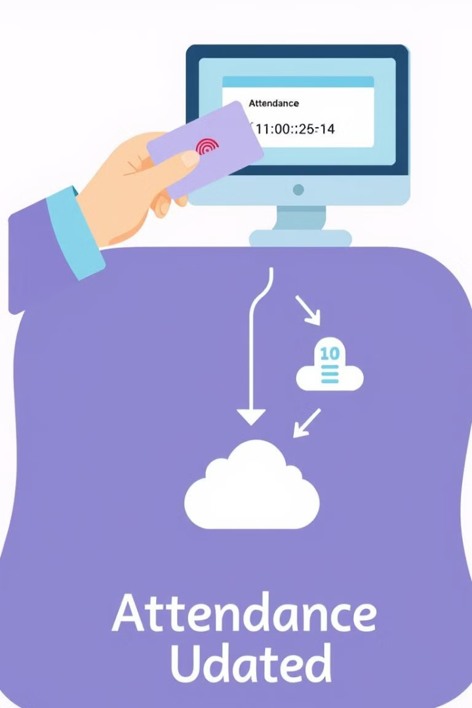




System Workflow
RFID Scan
Student scans their card.
Data Acquisition
ESP32 reads RFID tag.
Data Processing
Maps to student roll number.
Real-Time Update
Website displays roll number.

Slide 6

Benefits and Advantages
Automation
Real-Time
No manual processes.
Instant attendance monitoring.
Accuracy
Reduced errors.

Slide 7
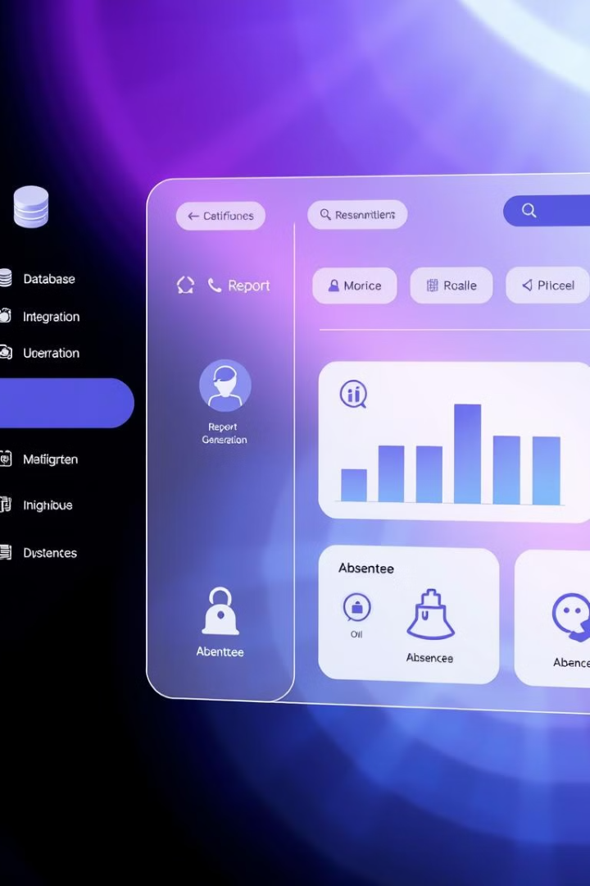




Potential Enhancements
Database Integration
User Authentication
Reporting Features
Mobile Responsiveness

Slide 8




Integration and Visualization
User interaction
Visual display
Real-time updates
Technology
2
3
1
4

Slide 9

Conclusion
The Real-Time Interactive RFID-Based Classroom Attendance System enhances accuracy, automates attendance, and delivers a user-friendly interface.

